Slide 1


Literature Review Presentation I
Batch No: 20CSEA003
Team members
V.Ganga Bhavani : 20K61A05G9
S.Venkateswara Rao : 20K61A05F3
K.Manasa Lakshmi : 20K61A0571
Guide
Dr. A V S Siva Rama Rao
Associate Professor,CSE.
Department of Computer Science and Engineering

Slide 2
An AI-Based Medical Chatbot Model for Infectious Disease Prediction
Title:
Authors: Mohd Asif Shah,Sanjay Chakraborty,Hrithik Paul,Sayani Ghatak
Publisher : IEEE
Published Year : 2022

Slide 3
Introduction
Chatbots can be used to provide information about COVID-19, answer questions, and even provide emotional support.
Chatbots have the potential to make healthcare more accessible, efficient, and personalized
Chatbots are becoming increasingly sophisticated, and they have the potential to revolutionize the way we interact with healthcare.
There are a number of ethical and regulatory issues that need to be considered when developing AI chatbots for healthcare.

Slide 4
Abstract
Chatbots have the potential to be a valuable tool in the fight against infectious diseases.
They can be used to provide information about diseases and treatments, answer questions, and even provide emotional support.
Chatbots have the potential to make healthcare more accessible, efficient, and personalized.
However, there are a number of challenges that need to be addressed before chatbots can be widely adopted in healthcare

Slide 5
Proposed Algorithm
The LSTM model is used to help the chatbot learn long-term dependencies between words.
The RNN model is used to help the chatbot learn sequential patterns in data.
The decision tree model is used to help the chatbot classify user queries into different categories.

Slide 6
Novelty of the paper
First, it is the first paper to propose the use of the LSTM algorithm for chatbot development.
Second, the paper provides a detailed analysis of the algorithm, which is not available in other papers.
Third, the paper shows that the LSTM algorithm is able to generate more accurate and relevant responses than other chatbot algorithms.

Slide 7
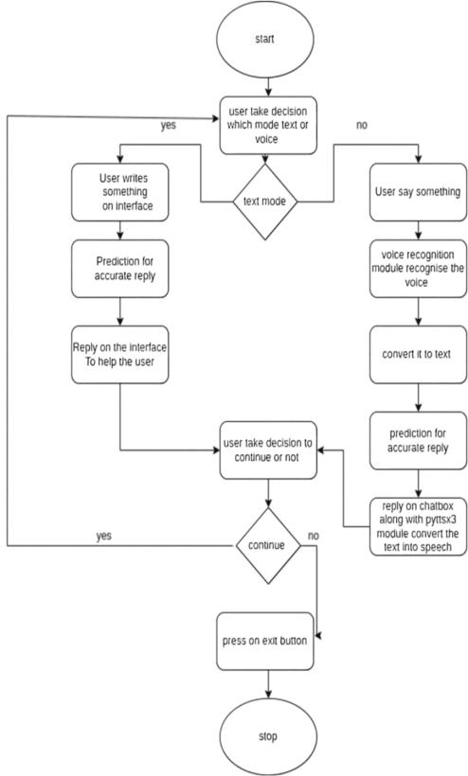
Block Diagram

Slide 8
Future work
Chatbots could be used to provide students with help with their coursework, such as answering questions about assignments.
Chatbots could be used to provide students with career advice, such as helping students to explore different career options, identify their strengths.
Chatbots could be used to support students' mental health, such as providing students with a safe space to talk about their problems.

Slide 9
The impact of a virtual teaching assistant (chatbot) on students’ learning
Title:
Authors: Hannah B. Essel (HBE),Andrew T. Mensah (ATM), Ebenezer Essilfie -Johnson(EEJ) Paul Kwame Boateng (PKB),David Vernon (DV)
Publisher : Springers
Published Year : 2022

Slide 10
Introduction
The research paper explores the integration of an AI-powered teaching assistant chatbot in a multimedia course in higher education.
It investigates the impact of student engagement with the chatbot on academic achievement and student satisfaction.
The study aims to address challenges posed by high student-teacher ratios and limited resources in educational settings, offering insights into the effectiveness of chatbot support for student learning.

Slide 11
Abstract
This chatbot is enhancing Higher Education Learning through AI-Powered Teaching Assistant
The study demonstrates that students who engaged with the chatbot achieved better academic performance and were satisfied with its instantaneous feedback.
While chatbots show promise in enhancing learning, some limitations in providing in-depth responses were identified, indicating areas for improvement.

Slide 12
Proposed Algorithm
This chatbot used a Quasi-experimental design to compare the performance of two cohorts of students. They are:
the experimental cohort, which interacted with a teaching assistant chatbot
the control cohort, which interacted with the course instructor.
This collects data from the two cohorts using a variety of methods, including surveys, interviews, and analysis of chat logs.
It has created a Whatsapp chat to implement this chatbot(AI).

Slide 13
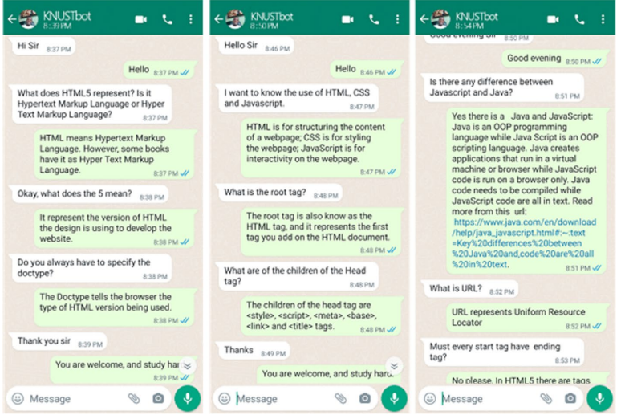
Fig. 1 The interface of the KNUSTbot

Slide 14
Novelty of the Paper
The novelty of this study includes:
context-specific approach
cost-effective technology integration
positive impact on academic performance
Implications for higher education institutions

Slide 15
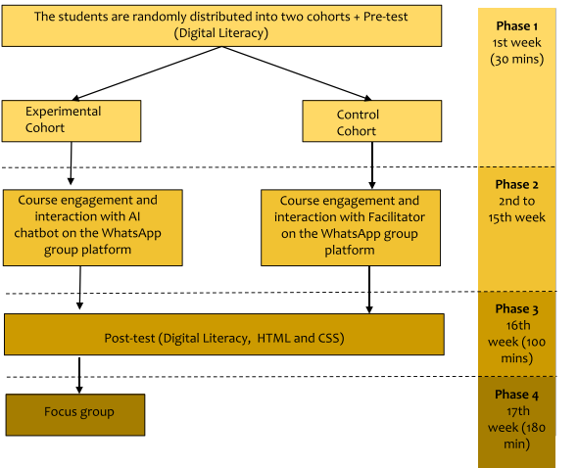
Block Diagram

Slide 16
Future Work
Conduct longitudinal studies to assess the sustained impact of chatbot interactions on student learning outcomes over time.
Enhance chatbot capabilities with natural language processing and machine learning algorithms for personalized learning paths and real-time feedback.
Explore ethical considerations, cost-benefit analysis, and teacher-chatbot collaboration to ensure responsible and effective integration in educational settings.

Slide 17
Can A Chatbot Comfort Human’s? Studying The Impact Of A Supportive Chatbot On User’s Self-Perceived Stress
Title:
Authors: Lenin Medeiros, Tibor Bosse, Charlotte Gerritsen.
Publisher : IEEE
Published Year : 2022

Slide 18
Introduction
The potential of chatbots in providing emotional support to humans.
It presents an experiment that investigates the effectiveness of a supportive chatbot in reducing users' self-perceived stress.
The study is conducted using a between-subjects design where groups of participants interact with different variants of the chatbot for three days in a row while reporting their subjective levels of stress before and after each interaction.

Slide 19
Abstract
It explains that the study aims to investigate the effectiveness of a chatbot in helping users cope with stressful situations.
It explains that social interactions between humans and computers have been studied for several decades.
The study is conducted using a between-subjects design where participants interact with different variants of the chatbot.

Slide 20
proposed algorithm
The algorithm consists of a mapping of stressors to support strategies.
In particular, there are seven clusters of stressors: financial, health, grief, work, relationship, school, and self-esteem.
The algorithm uses four different coping strategies: attentional deployment (AD), cognitive change (CC), general emotional support (GES), and situation modification (SM).
The support strategies are designed to help users cope with their stressors and include techniques such as problem-solving, cognitive restructuring, and emotion regulation.

Slide 21
Novality Of The Paper
The chatbot is designed to provide emotionally supportive text messages tailored to the stressful situations shared by participants.
The chatbot uses an algorithm to determine which text message to send based on the inputs provided by the user.
The algorithm maps stressors to support strategies based on Gross' emotion regulation theory.
The chatbot is implemented using text mining and natural language processing techniques to carry out small dialogues with social media users.

Slide 22
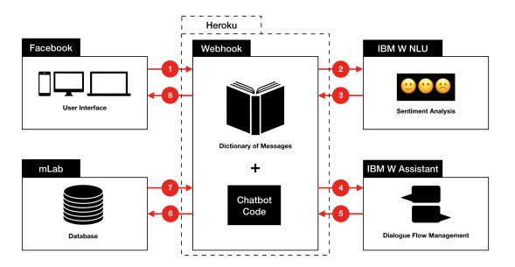
Block Diagram

Slide 23
Future Work
One potential solution is to incorporate techniques for building "rapport" with the user.
This way, the interaction with the agent could feel natural while users are rationally aware that they are talking to a bot.
Another suggestion is to explore the use of machine learning techniques to improve the chatbot's ability to understand and respond to user messages.

Slide 24
Paper Number | Algorithm Used | Proposed Work | What output? | Future Work
1 | Long Short-term Memory (LSTM) | Disease Predection Chatbot | Chatbot System That Can Answer Questions About COVID-19 | Develop A Chatbot For Educational Purposes.
2 | Quasi-experimental Design | Improve Personalised Learning | Chatbot Can Teach The Students Better Than Course Instructor | Need To Replicate With Larger Samples
3 | RNN,LSTM,NER | Supportive Chatbot For Humans | Proved That Chatbot Can Provide Emotional Support To Humans | Utilising This Feature In Educational Chatbot
4 | Natural language processing | Interaction and Engagement in Education | Human-likeness of AI-powered chatbots | Develop A Chatbot For Educational Purposes.

Slide 25
THANK YOU

